Slide 1

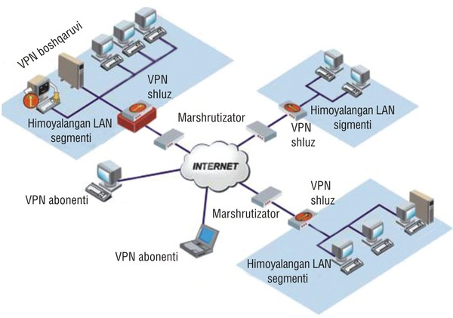
TARMOQ ADMINISTRATORLIGI 31-DARS

Slide 2

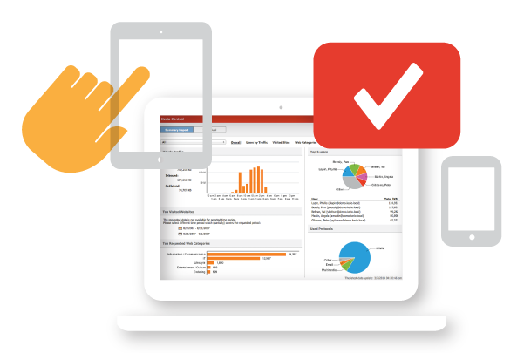

KERIO CONTROL

Slide 3
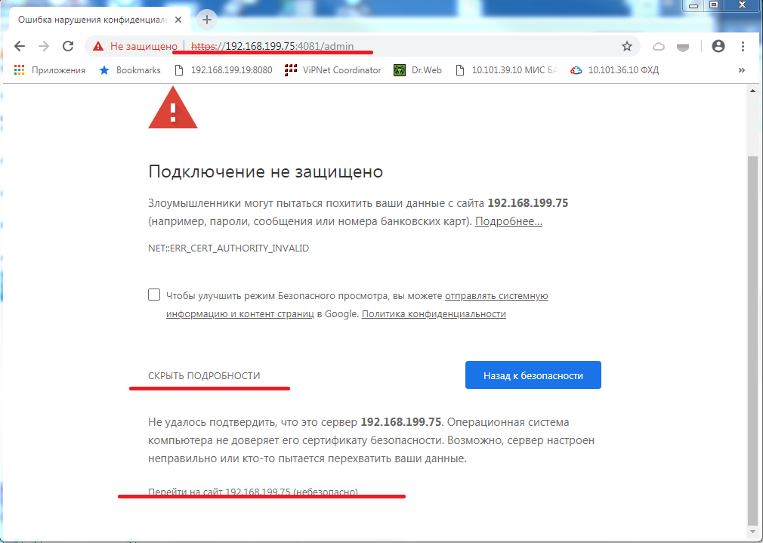
KERIO CONTROL

Slide 4
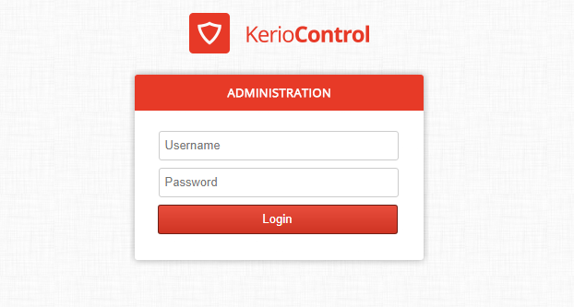
KERIO CONTROL

Slide 5
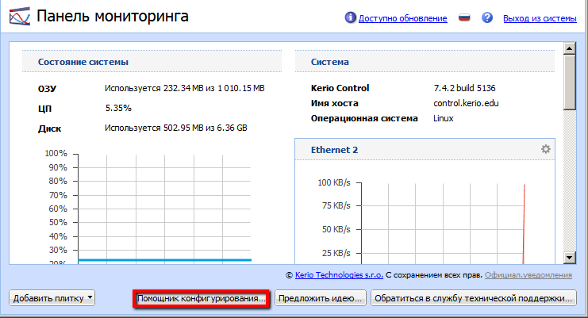
EXPORT CONF KERIO CONTROL

Slide 6
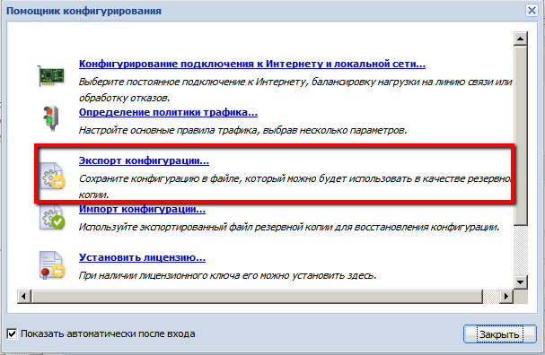
EXPORT CONF KERIO CONTROL

Slide 7
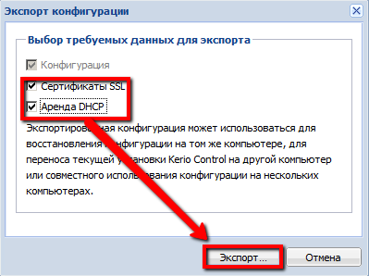
EXPORT CONF KERIO CONTROL

Slide 8
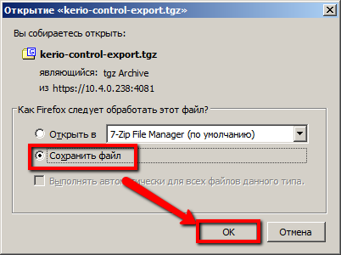
EXPORT CONF KERIO CONTROL

Slide 9
EXPORT CONF KERIO CONTROL

Slide 10
IMPORT CONF KERIO CONTROL

Slide 11
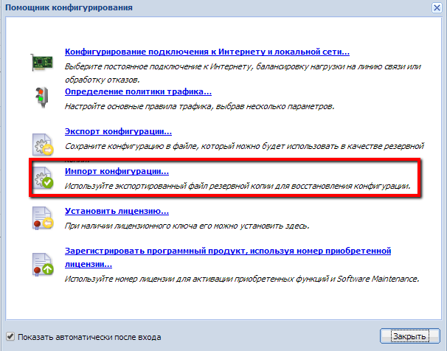
IMPORT CONF KERIO CONTROL

Slide 12
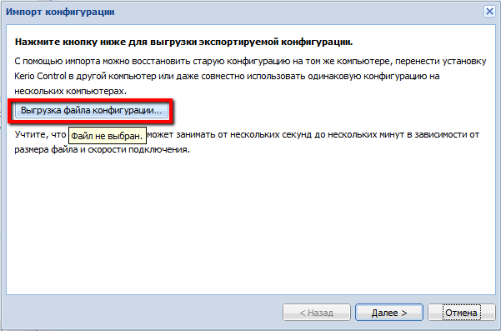
IMPORT CONF KERIO CONTROL

Slide 13
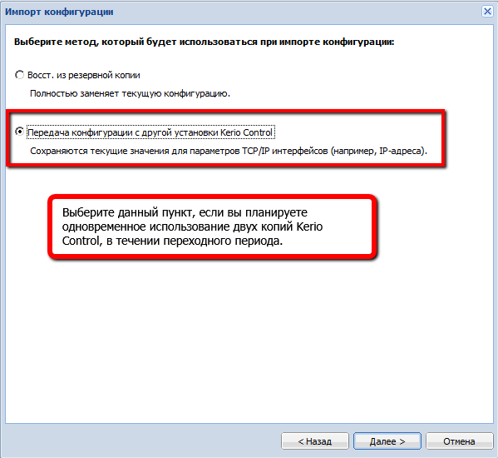
IMPORT CONF KERIO CONTROL

Slide 14
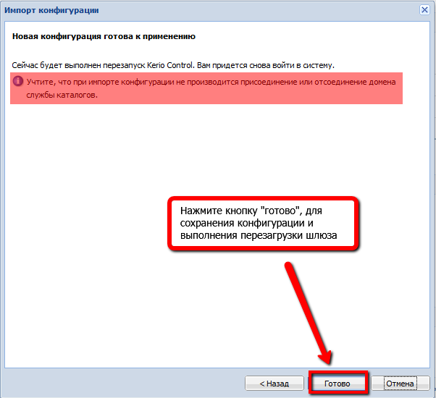
IMPORT CONF KERIO CONTROL

Slide 15
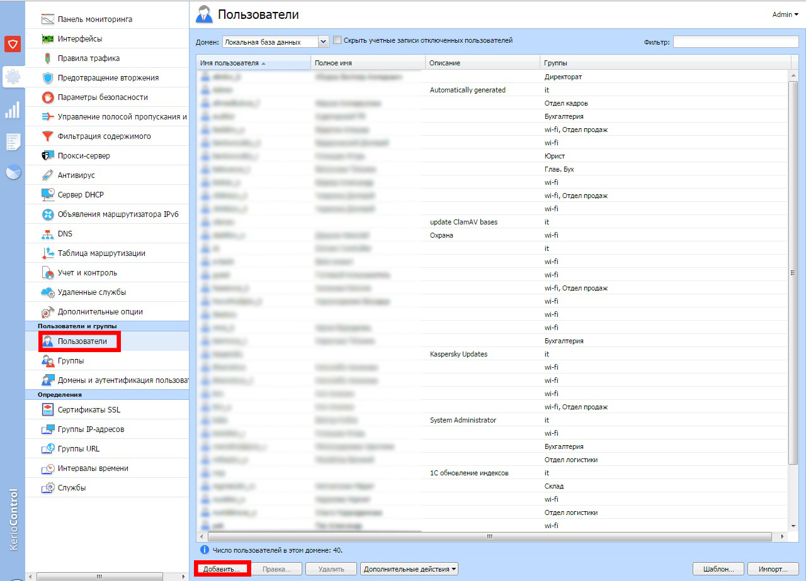
ADD USER KERIO CONTROL

Slide 16
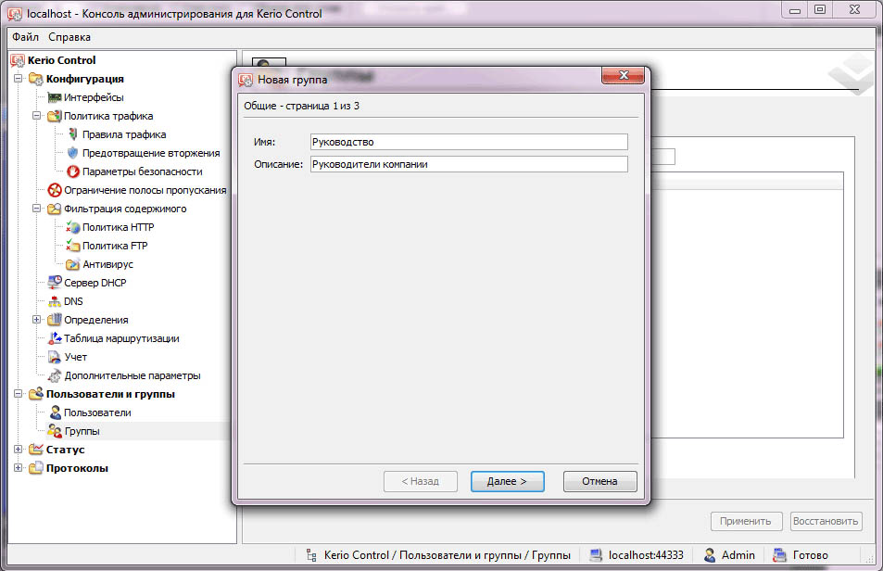
ADD GROUP KERIO CONTROL

Slide 17
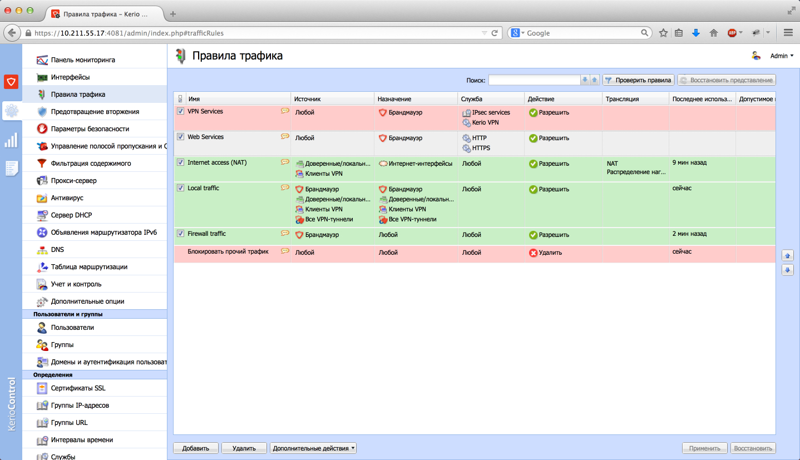
KERIO CONTROL

Slide 18
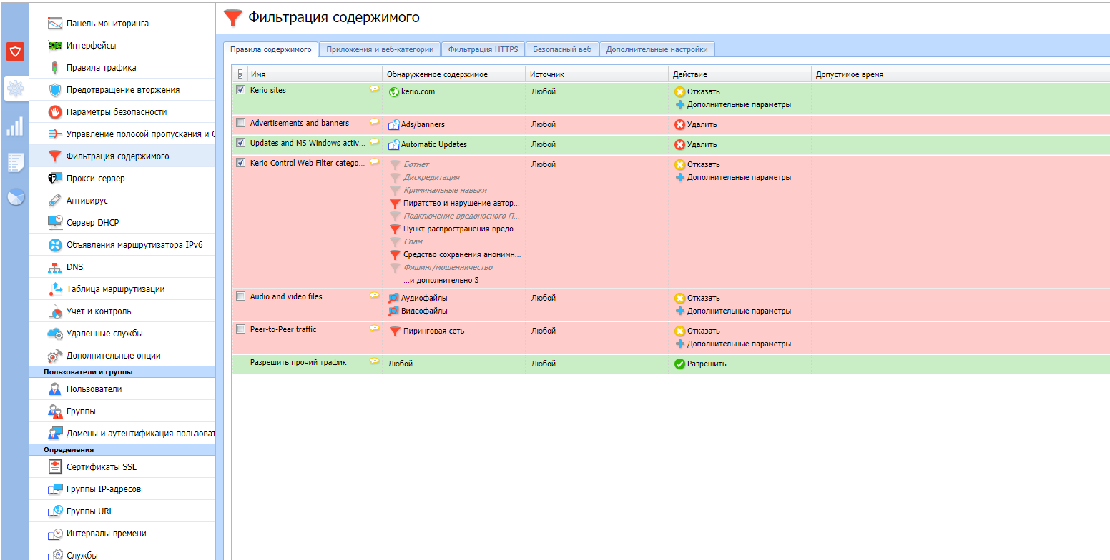
KERIO CONTROL

Slide 19
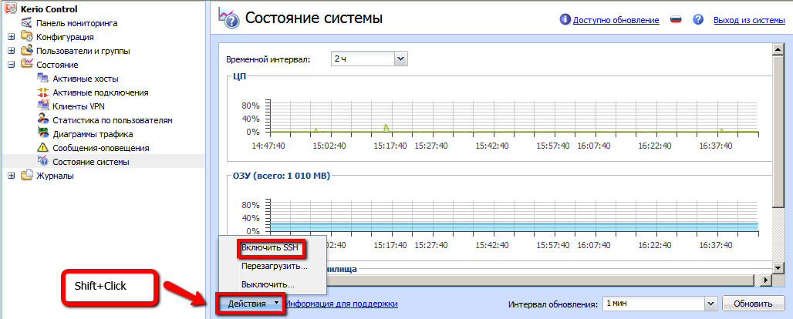
ENABLE SSH KERIO CONTROL

Slide 20
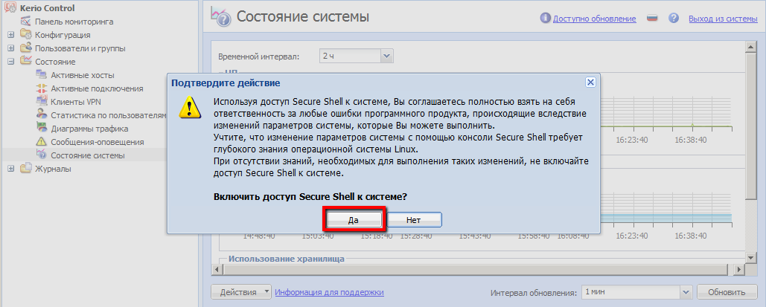
ENABLE SSH KERIO CONTROL

Slide 21
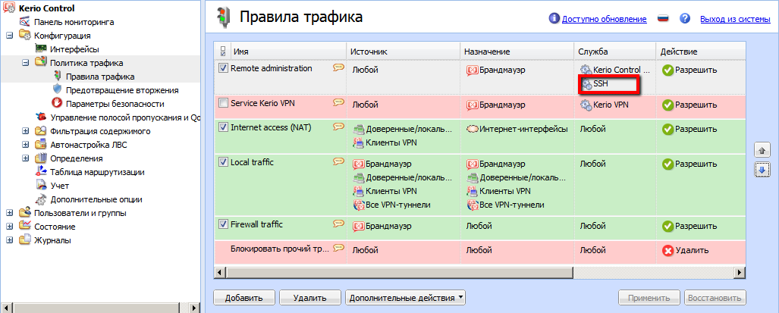
REMOTE SET SSH KERIO CONTROL

